Slide 1


CX/AX ODOO CRM TRAINING

Slide 2

AGENT CRM BACKGROUND
What is Odoo?
All-in-one management software that offers a range of business applications that form a complete suite of enterprise management applications targeting companies of all sizes. Some of the modules in Odoo are CRM, website/e-commerce, billing, finance and accounting, manufacturing, warehouse and inventory, project management, HR, among others.
KOKO Networks has developed and deployed a Customer Relationship Management tool on Odoo, to fulfill the business needs of the TDR, RM, Customer Service and Technician teams to fulfill agent onboarding requirements.

Slide 3
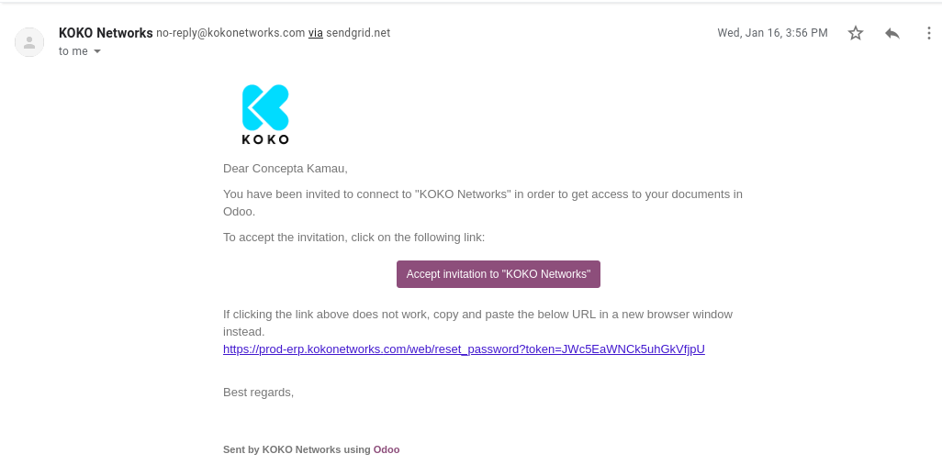
ACCESSING ODOO Agent CRM
Invitation email to log in to Odoo:

Slide 4
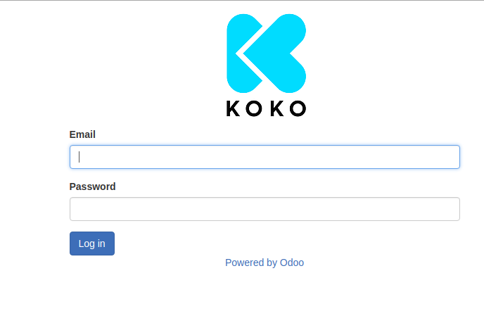
ACCESSING ODOO Agent CRM
Username (company email address): c.kamau@kokonetworks.com
Password: **********

Slide 5
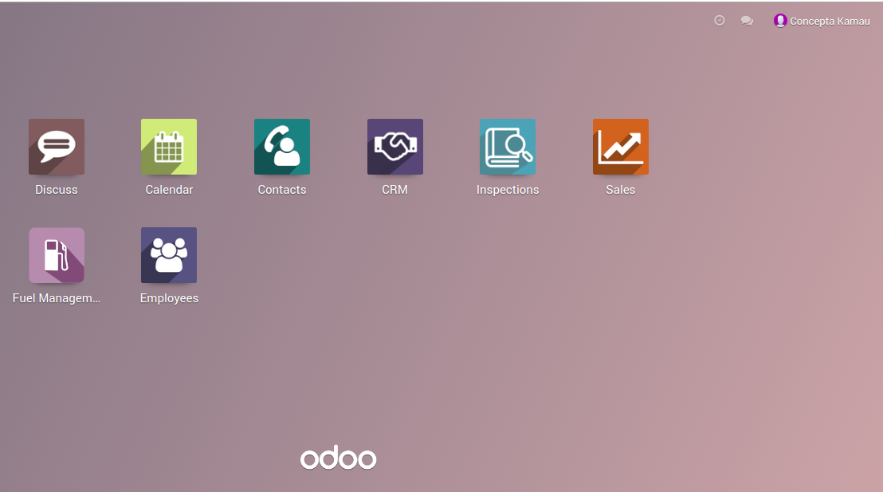
HOME SCREEN
After Log in:

Slide 6
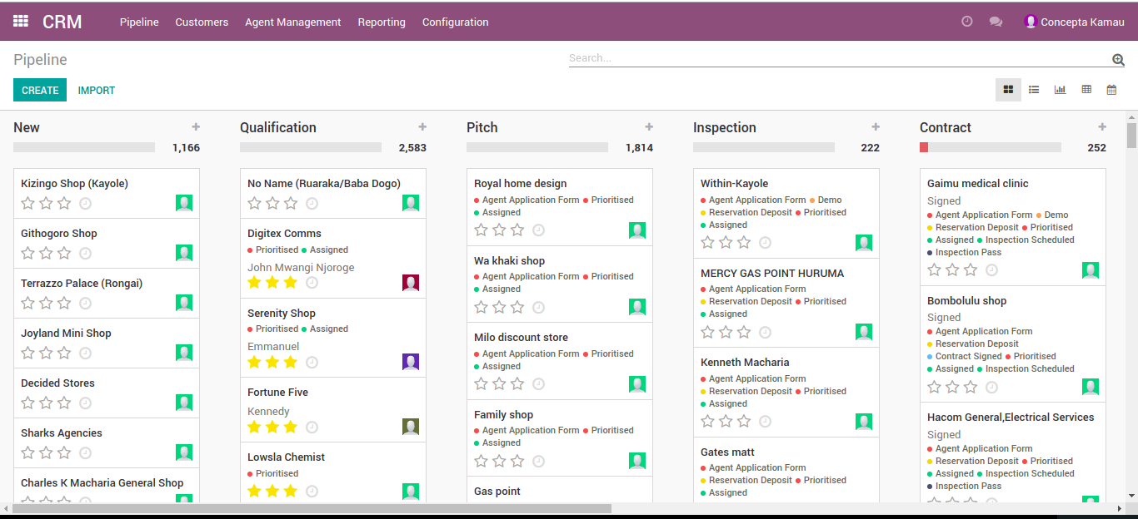
MENU: CRM
CRM menus: Pipeline, Customers, Agent Management, Reporting
Notes:
Discuss CRM Menus:
Pipeline- all opportunities are tracked from new to contract (when a lead is won). All interactions between KNK (TDR, AX/CX, Marketing) are recorded for each opportunity.
Customers: This is where all customer information will be
Agent Management- where TDRs schedule their tasks, Sales meetings are recorded and Inspections are scheduled and recorded
Reporting- to generate reports.
In Pipeline we have various stages:
New- for any new opportunities identified by TDR
Qualification- this is where opportunities are quickly assessed and prioritized based on the TDR task scores/ survey
Pitch- Meetings are held with the Agent to discuss and propose the KP idea, an application form is filled and a deposit is paid by the agent
Inspection- this is where inspection is done and the results recorded to determine if the agent physical location is viable for setting up of a KP
Contract- If viable, the agent is offered a contract to accept/decline

Slide 7
Agent Management Communication Touchpoints V3
Stage
Qualification
Pitch
Inspection
Contract
Mods & Civil Works
Installation
Prioritized
Assigned
Application Form
Initial Deposit
Inspection
Inspection Report
Contract
Balance
Landlord approval
Mod completion confirmation
Installation
Branding
First fuelling
Milestone
Survey
Pitch < (TBC) # meetings
Collect App & Dep
Deliver feedback & contract
Collect contract & balance
Deliver Welcome Pack & KOKO signed contract
TDR
<2 weeks of inspection
SLA?
SLA?
Confirm receipt of payment & next steps
Confirm receipt of payment & next steps
Confirm receipt of welcome pack
Courtesy call in intervals to launch?
AX
< 24 hours of deposit
<24 hours of balance
<24 hours of welcome pack
SLA?
Deployment
Schedule Inspection
Complete Inspection
Provide Report
Schedule Mods & Civil Works
Complete Mods & Civil Works
Schedule Installation
Complete Installation
SLA?
<3 weeks of payment
< 1 day of inspection
SLA?
<3 weeks of contract
SLA?
<4 weeks of civil works
Reconcile deposit payments
Reconcile balance payments
Legal & Finance
Weekly
Weekly
Return signed contract
Check KRA license & bus permit & ID
Chase KRA, license & bus permit & ID
Notes:
TDR = face to agent & lead in the journey from qualification to installation (mission = lead Agent through sales process up through installation)
AX = back-up support for agents + validation of TDR process adherence (mission = ensure consistent and positive Agent experience)
Deployment = technology setup and delivery (mission = prepare shop for installation + install KP effectively)

Slide 8
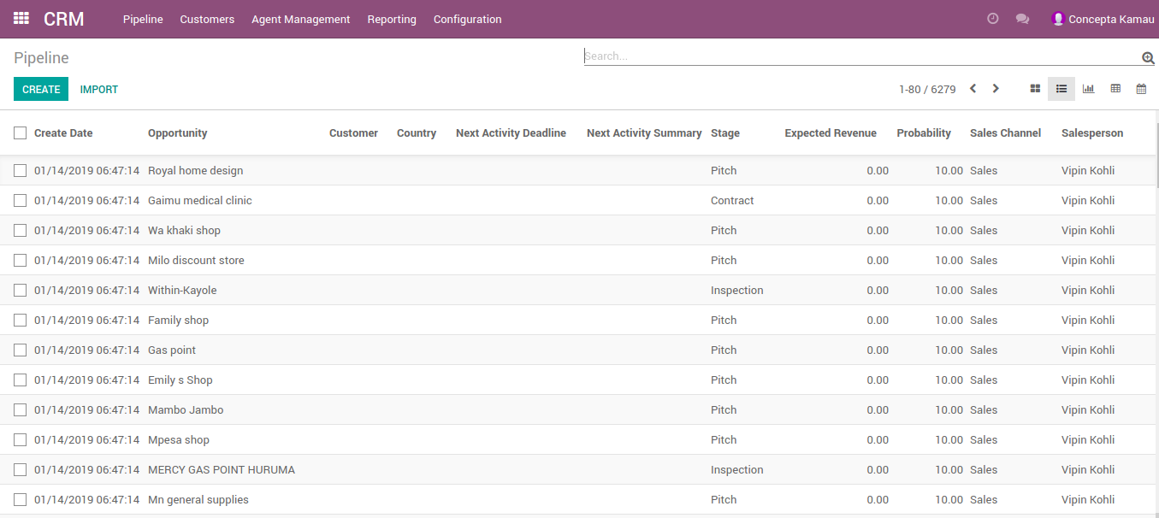
PIPELINE
How to access Opportunities in different stages:
Notes:
Using the list view

Slide 9
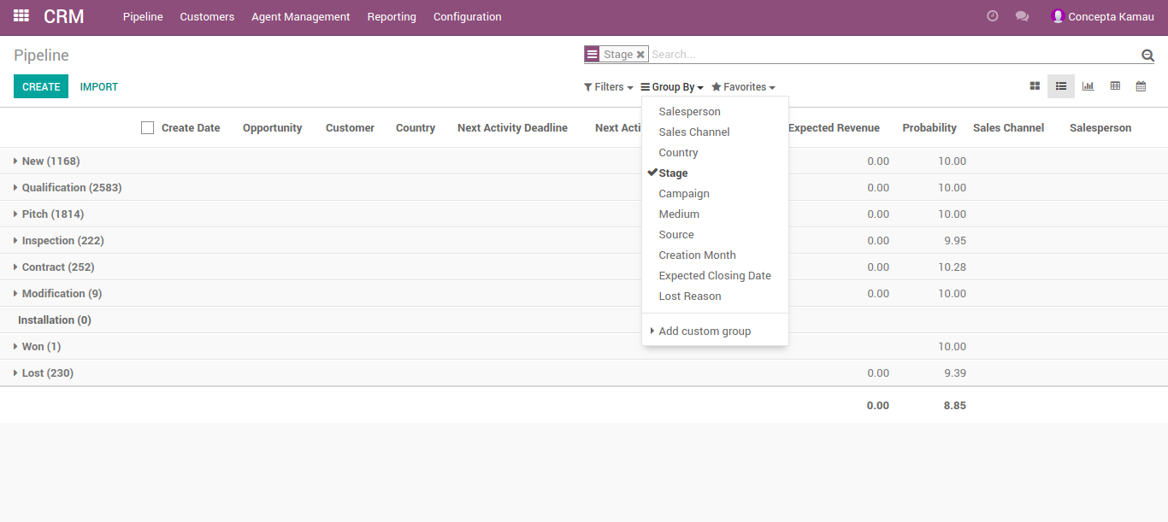
FILTERING/GROUPING
Group by Stage as below:
Notes:
Using the list view

Slide 10
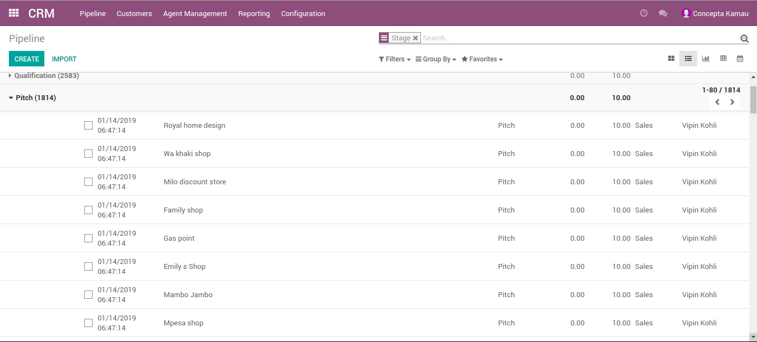
ACCESSING SINGLE AGENT OPPORTUNITY
Expand the List in a Stage
Notes:
Using the list view

Slide 11
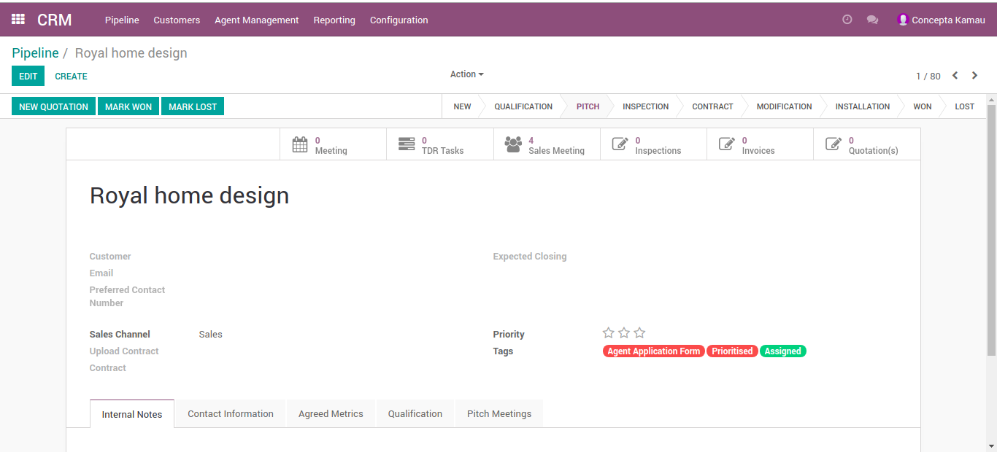
OPPORTUNITY INFORMATION
Access opportunity information:
Notes:
Using the list view

Slide 12
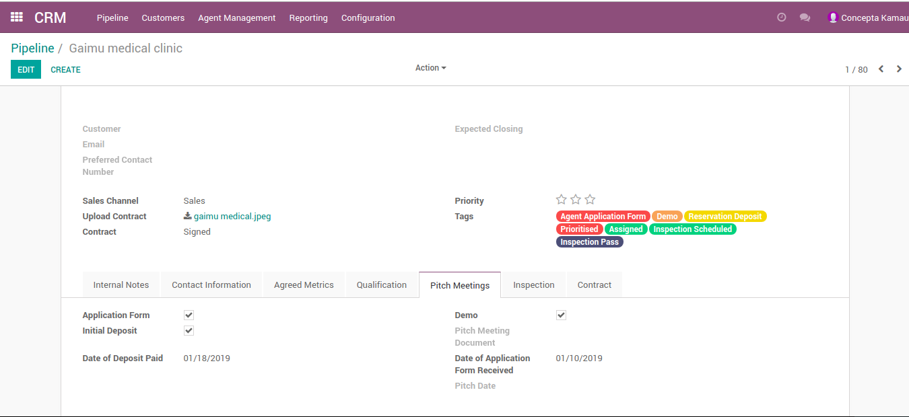
SUBMENUS IN OPPORTUNITY PAGE
Access Agent information:
Notes:
Tags give visibility of the various activities done for the agent
Contact information- Agent contacts and details
Qualification tab- assigned and prioritised
Pitch Meetings- check if Application form, initial deposit paid and date, demo done, pitch meeting document, date of application and pitch date
Inspection Tab- Inspection pass, fail or scheduled and date inspection was done
Contract- contract, agent signed, KOKO signed

Slide 13
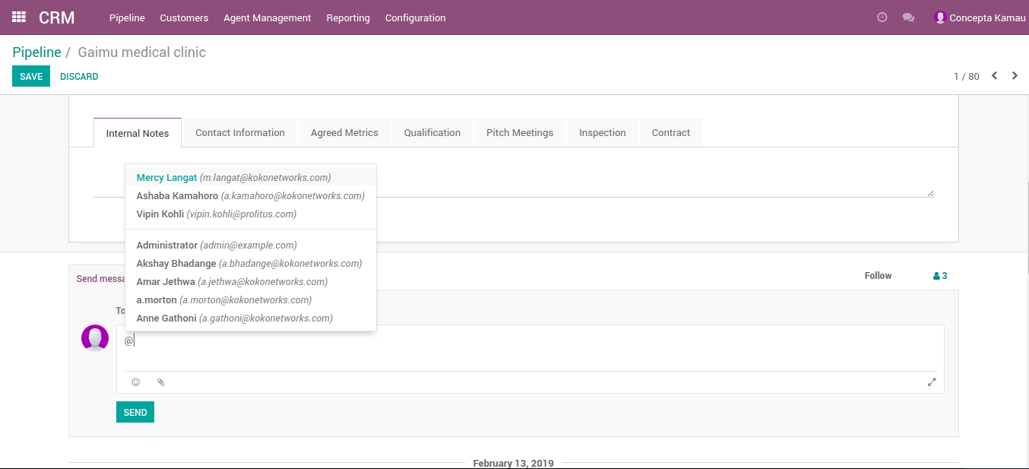
SEND MESSAGE
Send Message:
Notes:
Use send message to send a message and notification to a TDR and all other followers of the Agent in pipeline via email. Use @ sign to tag a specific person. It will create a log as well

Slide 14
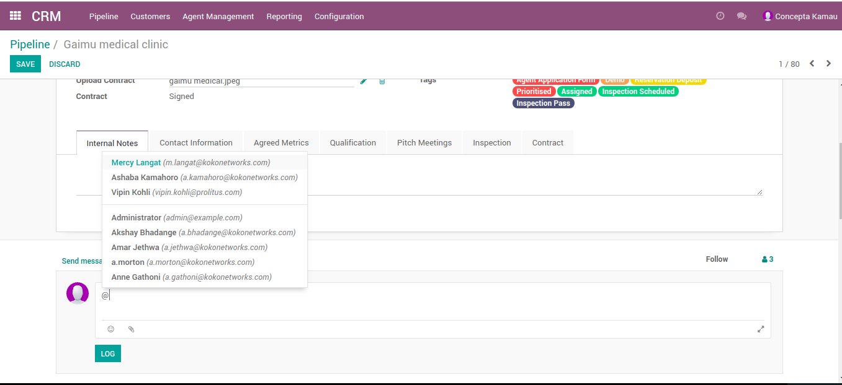
LOGGING NOTES
Log Note
Notes:
Use Log Note when you do not want a notification to be sent via email, but want it as a record under the opportunity. You may still tag someone using @ sign

Slide 15
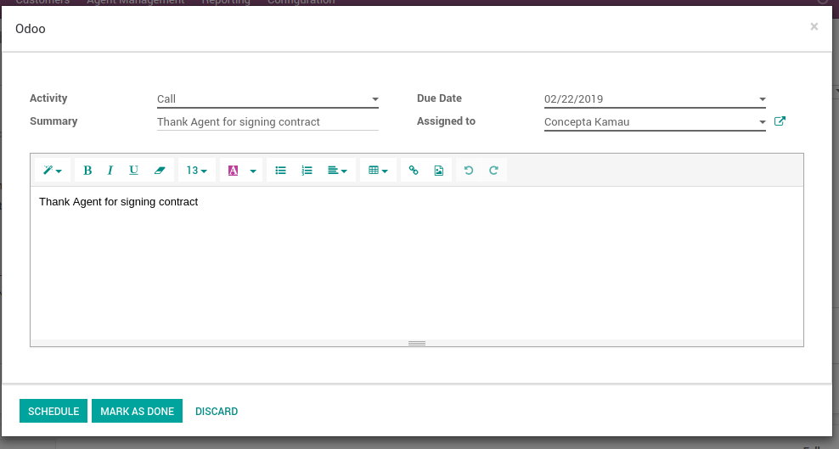
SCHEDULE ACTIVITY
Schedule Activity:
Notes:
You can schedule an activity: Email, Call, Meeting or To Do
Put in a Due date
Summary of the scheduled activity
Assign to someone and schedule

Slide 16
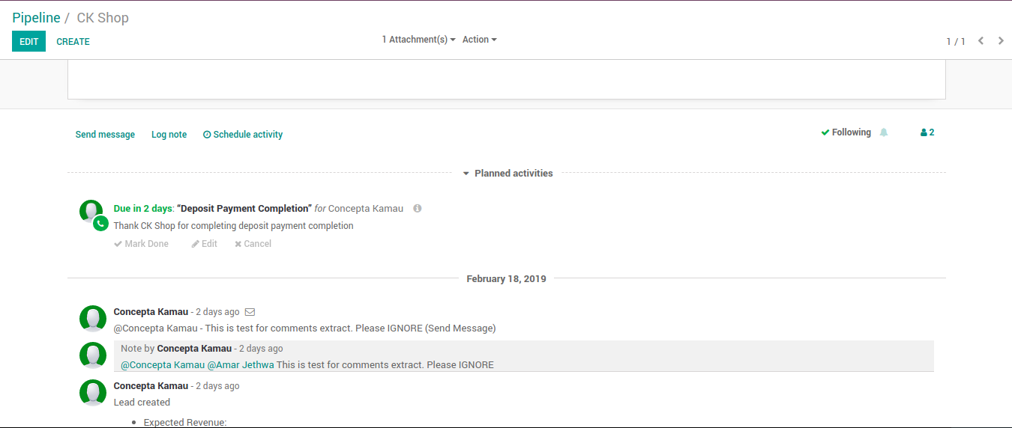
SCHEDULE ACTIVITY
Scheduled Activity:
Notes:
You can schedule an activity: Email, Call, Meeting or To Do
Put in a Due date
Summary of the scheduled activity
Assign to someone and schedule

Slide 17
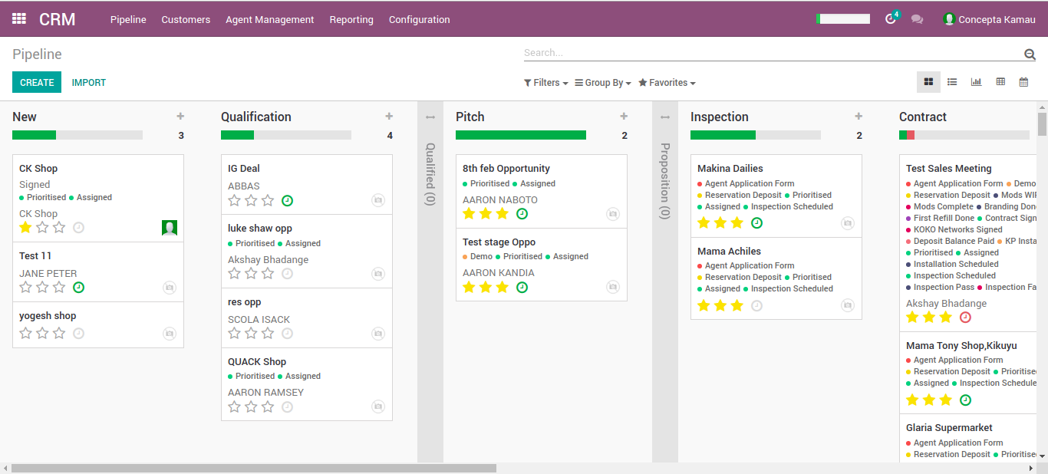
SCHEDULE ACTIVITY
Scheduled activities on pipeline dashboard:
Notes:
Clock Icon for scheduled activity

Slide 18
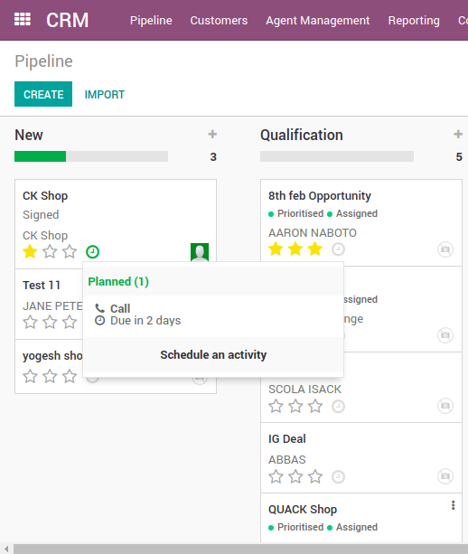
SCHEDULE ACTIVITY
Scheduled Activity:
Notes:
Clock Icon for scheduled activity

Slide 19
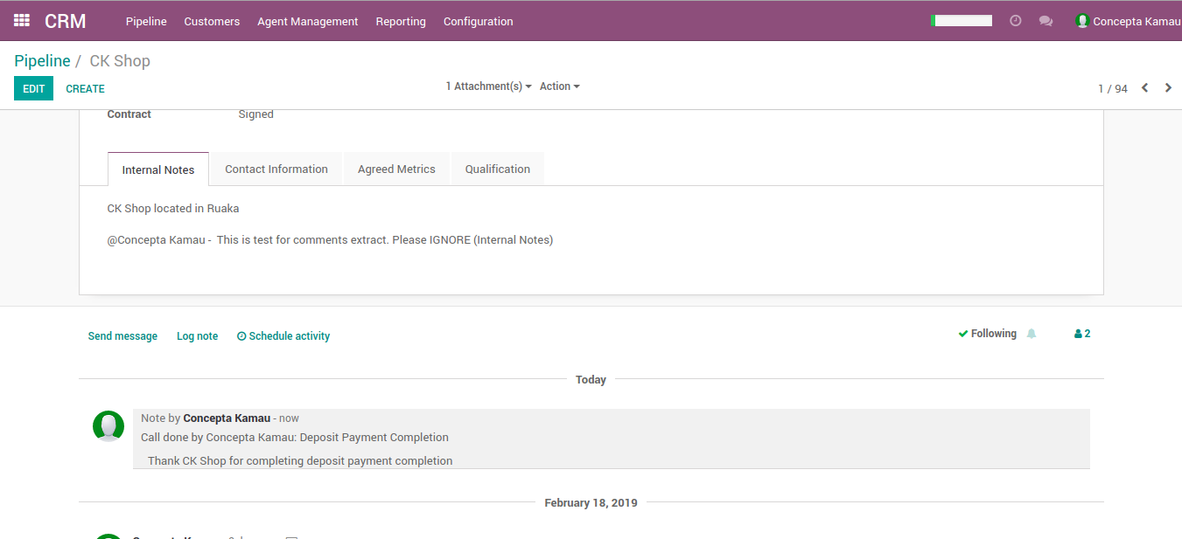
SCHEDULE ACTIVITY
Mark as done, logged in notes:
Notes:
When you mark as done, it appears in Logs

Slide 20
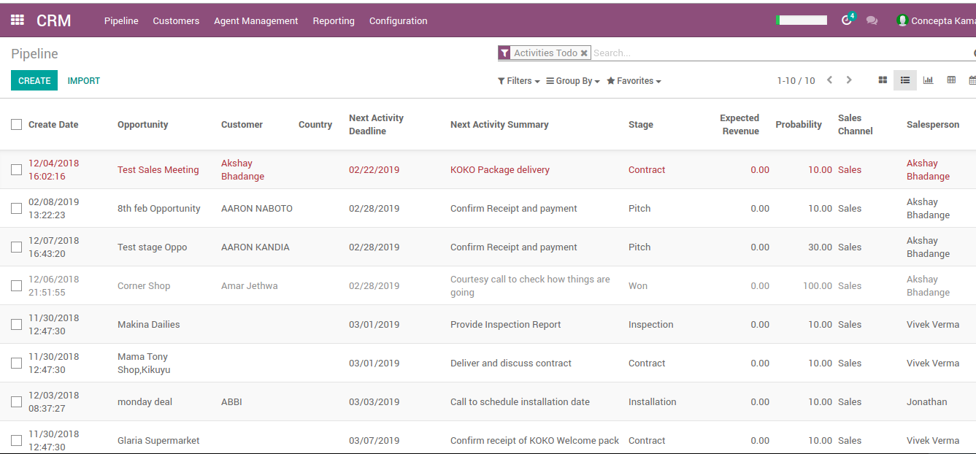
SCHEDULE ACTIVITY
View next activities:
Notes:
View Next Activity in List View- in red means it is overdue

Slide 21
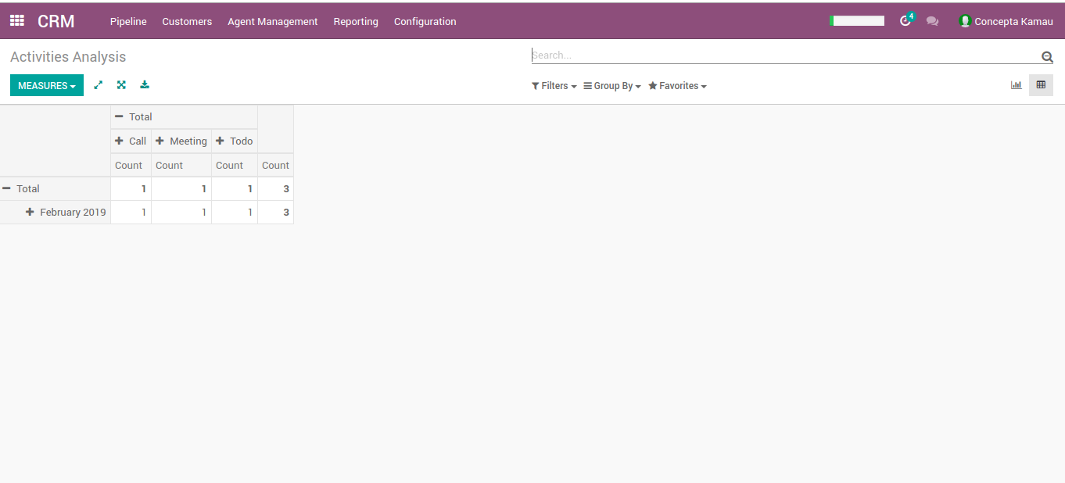
SCHEDULE ACTIVITY- REPORTING
Scheduled Activities Reporting
Notes:
Reporting-->Activities, then list by calendar

Slide 22
Q&A

Slide 23


